Slide 1

Exploratory Data Analysis
G2M Case Study
19 May 2022

Slide 2

Agenda
Background
Problem Statement
Approach
EDA
EDA Summary
Recommendations

Slide 3
Background
XYZ is a private firm in US. Due to remarkable growth in the Cab Industry in last few years and multiple key players in the market, it is planning for an investment in Cab industry.

Slide 4
Problem Statement
Per their Go-to-Market(G2M) strategy XYZ want to understand the market before taking final decision. And next is an Exploratory Data Analysis (EDA).

Slide 5
Approach
Analysing four data sets about the two cab companies: Yellow and Pink cab.
Get some result to compare the customers base and the profit for each company.
Recommend the better investment option based on the analytics.

Slide 6
EDA
Customer Base Analysis
Profit Analysis
Rides Analysis

Slide 7
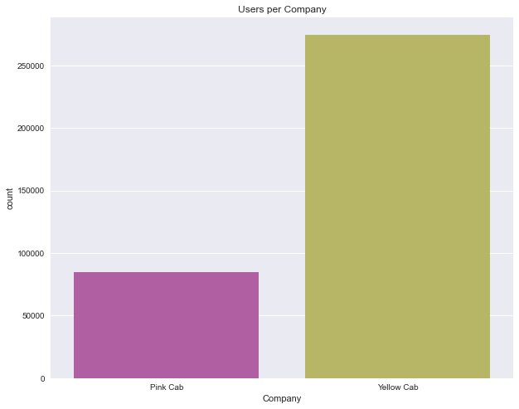
Users
The Yellow Cab Company has more users

Slide 8
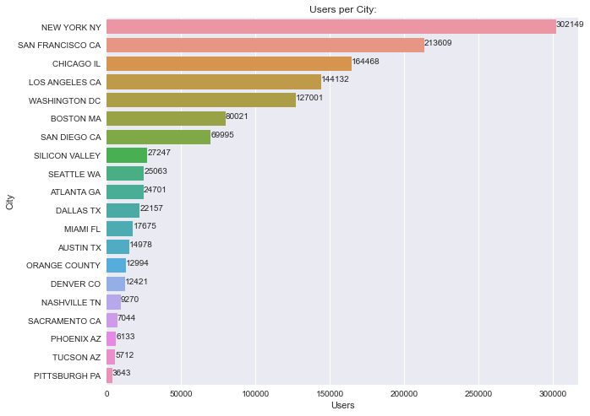
Cities
NY has the most users followed by SF and Chicago

Slide 9
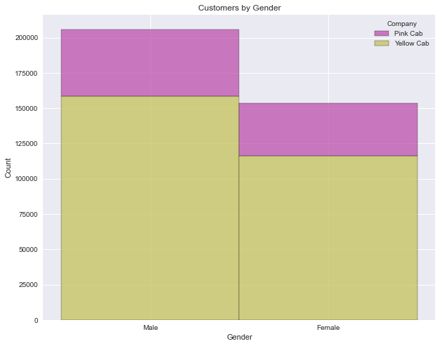
Gender
There's more male customers
in both companies

Slide 10
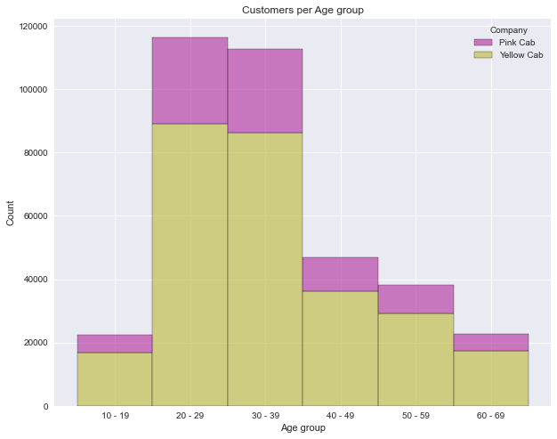
Age
Most customers are between the age of 20-39

Slide 11
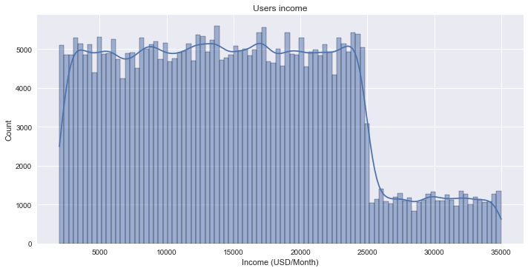
Income
Most customers has middle income

Slide 12
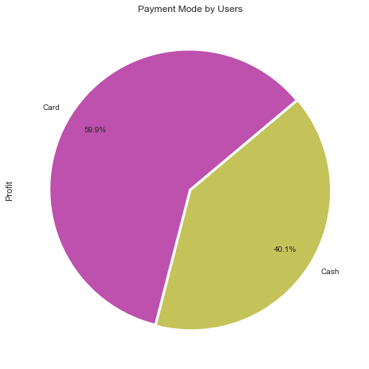
Payment
59.9% prefer paying by cards

Slide 13
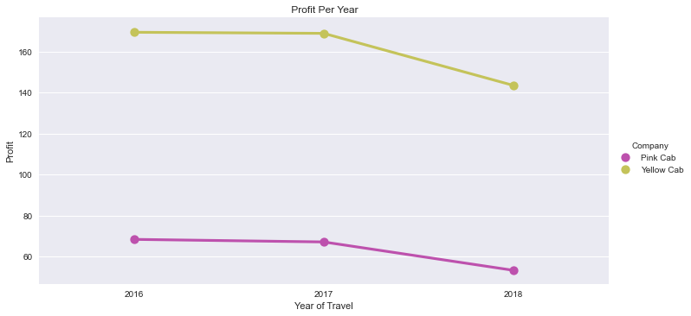
Yearly Profit
both companies has a better profit in the year 2017

Slide 14
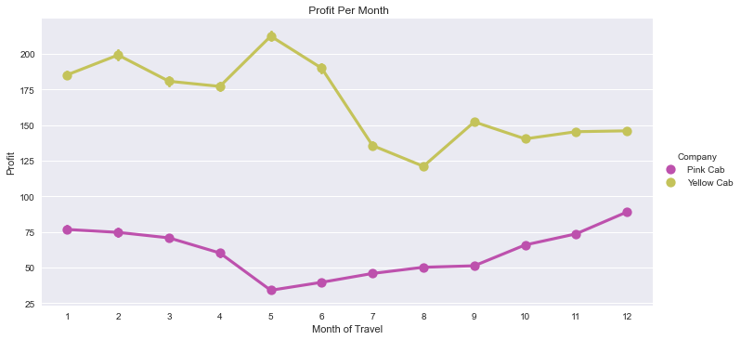
Monthly Profit
Both has better profit at the end and the start of the year but it differ in the middle

Slide 15
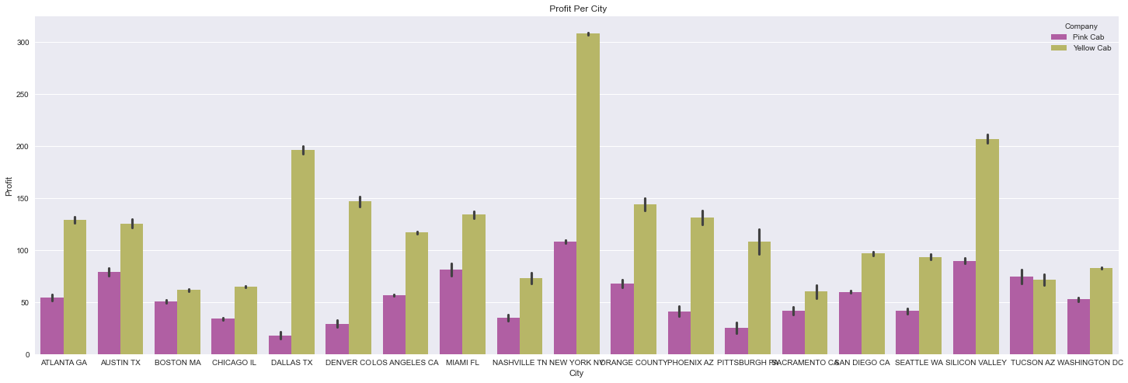
Profit per city
NY is the most profiting city and even though Dallas in the top third for the Yellow cab it's not the same for Pink cab

Slide 16
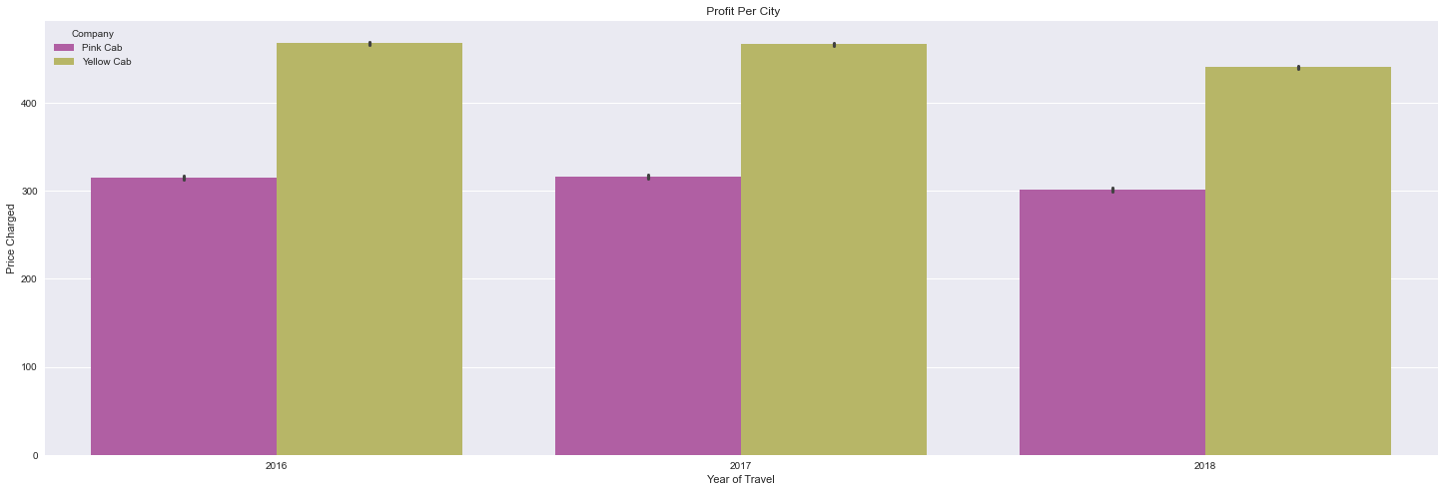
Price charged
The Yellow cab charge more

Slide 17
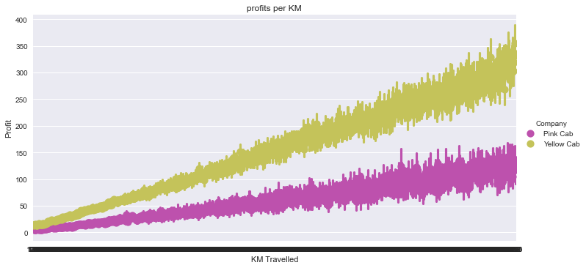
Profits per KM
The profit increase with longer distance and Yellow cab profit is higher

Slide 18
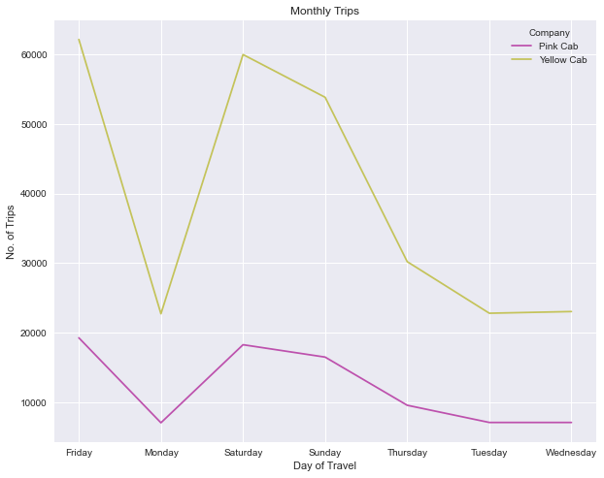
Daily Rides
Weekend has more trips than the rest of the week

Slide 19
Summary &Recommendations
Over All the Yellow cab performed better in different aspects and has a better reach and profits than the Pink cab based on the analytics.
Costumers: Yellow cab reach more customers and has more users than the Pink Company
Company: Even though the Yellow cab charge more than the Pink cab the users still prefer it
Profit: Since the Yellow cab has more customers the profit can increase with investments

Slide 20
Thank You

